Slide 1







LMS
Project
Presented by: NF2S Group
19-10-2024

Slide 2

Our Team
Nada Hossam
Jakleen Eskander
Fatma Tarek
Sherehan Mohamed
Shimaa Shafik
Supervision
Fatma Tolba

Slide 3
Overview
Introduction
Project Overview
System Architecture
Key Features
Demo
Conclusions
Future Enhancements

Slide 4




Introduction
Problem
Tratditional library management systems are often manual, time-consuming, and prone to errors. This inefficiency can lead to delays, lost resources, and a poor user experience.
Objective
Create a modern, automated library management system that streamlines processes, improves efficiency, and provides a better user experience.
Target Audiance
Librarians, library staff, and library patrons

Slide 5


Project overview
Description
Technology
Digram
This project focuses on developing a Library Management System using ASP.NET Core. This system aims to automate book checkouts, returns, penalty calculations, and member management. Users can efficiently search for available books, simplifying the library experience.
.
+--------------------+
| User Interface | (HTML, CSS)
+--------------------+
+--------------------+
| Business Logic | (ASP.NET Core MVC)
+--------------------+
+--------------------+
| Data Access Layer | (Entity Framework)
+--------------------+
+--------------------+
| SQL Server | (Database)
+--------------------+
Frontend : HTML, CSS, Bootstrap, Jquery.
Backend:
ASP.NET Core (MVC).
Entity Framework.
SQL Server.

Slide 6
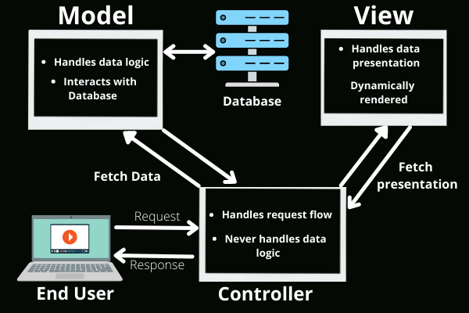


MVC Architecture
Notes:
Model: Represents the data and business logic of the application. In this case, it would include classes for books, members, and other relevant entities.
View: Handles the user interface and presentation of data. It renders the HTML pages and displays information to the user.
Controller: Acts as the intermediary between the Model and View. It receives user requests, interacts with the Model to retrieve or update data, and then chooses the appropriate View to display the results.
Data Flow:
User Interaction: The user interacts with the View (e.g., clicks a button, enters data).
Controller Processing: The View sends the user's action to the Controller. The Controller processes the request, possibly interacting with the Model to retrieve or update data.
Model Interaction: The Controller may call methods on the Model to perform business logic or access data from the database.
View Update: The Controller chooses the appropriate View to display the updated data or results to the user.

Slide 7
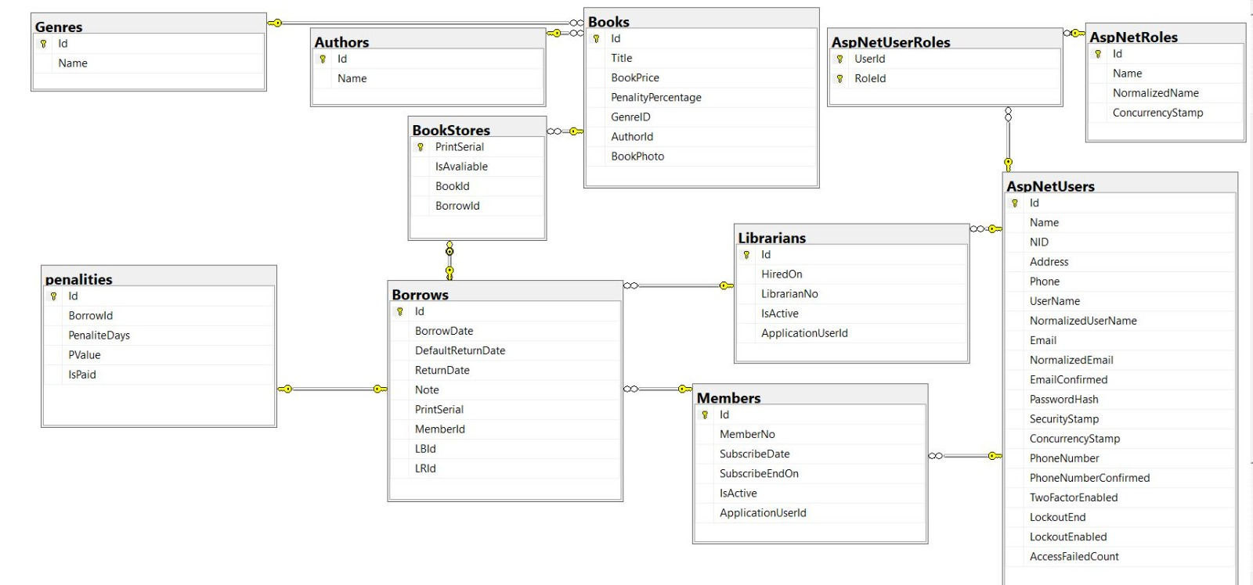
Database Design
Notes:
Model: Represents the data and business logic of the application. In this case, it would include classes for books, members, and other relevant entities.
View: Handles the user interface and presentation of data. It renders the HTML pages and displays information to the user.
Controller: Acts as the intermediary between the Model and View. It receives user requests, interacts with the Model to retrieve or update data, and then chooses the appropriate View to display the results.
Data Flow:
User Interaction: The user interacts with the View (e.g., clicks a button, enters data).
Controller Processing: The View sends the user's action to the Controller. The Controller processes the request, possibly interacting with the Model to retrieve or update data.
Model Interaction: The Controller may call methods on the Model to perform business logic or access data from the database.
View Update: The Controller chooses the appropriate View to display the updated data or results to the user.

Slide 8




Key Features
Authentication
&
Authorization
CRUD Operations
Search & Filter
User Roles.
Login Mechanisms.
Authorization.
Books.
Members.
Checkouts (Borrow/Returns).
Book Search: Users can search for books by title, author, genre.

Slide 9
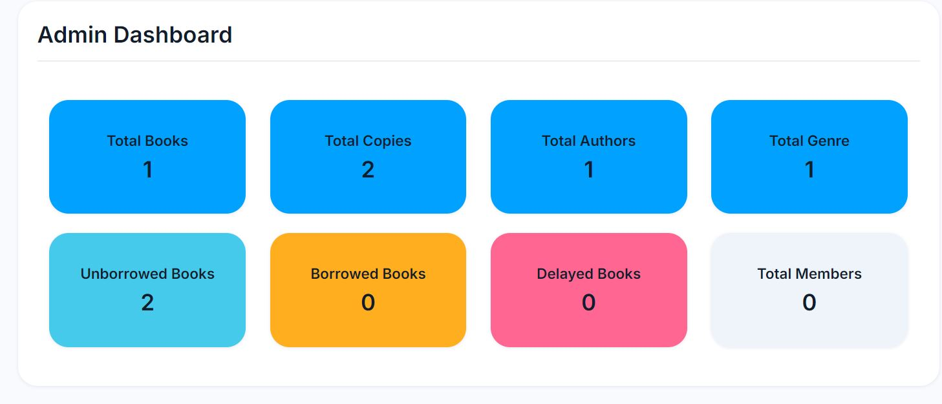
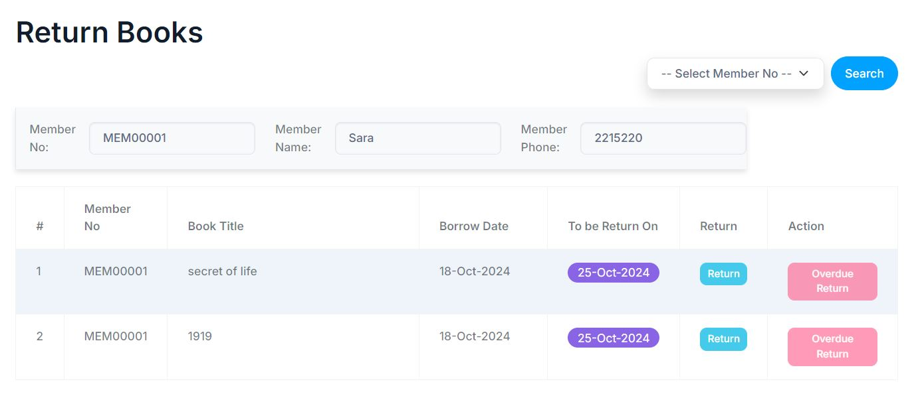


Project Demonstration
Dashboard
Return Page

Slide 10

Demo

Slide 11









Challenges and Solutions
Data Consistency
Ensuring data consistency across different tables (e.g., preventing duplicate book records, updating related records when a member's information changes)..
Use database constraints (e.g., foreign keys) to enforce data integrity..
Optimize database queries using indexes and query tuning techniques.
Penalties and Return Date Calculations
The service was thoroughly tested to ensure it worked for all scenarios, including edge cases where books were returned right on the due date or with significant delays.
The logic for calculating penalties based on the return date was encapsulated in a service class (PenaltyService), which handled all business rules related to due dates, grace periods, and penalty rates
Calculating penalties based on the due date of book returns
involved complex logic, particularly when taking into account grace periods, exceptions for holidays, and different penalty rates for overdue days.
Ensuring this logic worked smoothly required thorough testing and validation
This approach centralized the penalty logic and made it easier to manage and modify in the future

Slide 12
Future Enhancements
Real-Time Notifications
Mobile App Integration
Advanced Search Features
Multi-Language Support
Librarians and members would receive real-time alerts when books are overdue or when penalties are updated, improving communication and helping members avoid additional penalties.
.
A mobile app for members and librarians would allow users to manage their accounts, check book availability, and perform other tasks on the go. This would improve user accessibility and engagement with the system.
This would allow users to perform more granular searches, helping them find specific books faster. Advanced filtering could also improve usability when managing large inventories.
Add multi-language support to improve accessibility for users in different regions.
By supporting multiple languages, the system can cater to a broader audience, allowing users to switch between languages in the interface.

Slide 13





Conclusions
01
02
03
04
Technical Skills
Gained proficiency in ASP.NET Core, MVC, Entity Framework, and SQL Server.
Problem-Solving
Developed problem-solving skills to address challenges related to data consistency, performance optimization, and security.
Project Management
Learned effective project management practices, including planning, execution, and testing.
Collaboration
Enhanced collaboration skills by working with team members and stakeholders.

Slide 14

Thank's For Watching

